Slide 1

Beyond the Order
Building Reliable and Reusable E-Commerce Data
Presented by :
Course:
Team 2, Hercules
Data Management

Slide 2
Dataset metadata
  Provider: Olist
  Platform: Kaggle
  Original publication: 2018
  DOI: https://doi.org/10.34740/kaggle/dsv/195341
  Dataset version: 7
  Format: 9 CSV files
  Licence: CC BY-NC-SA 4.0
  Geographic scope: Brazil
  Purchase Period: 4 September 2016 – 17 October 2018
Dataset

Slide 3
Improving E-Commerce Delivery Performance and Customer Satisfaction.
How can marketplace operations teams integrate and quality-assure order, payment, product, seller, delivery and customer-review data to identify operational factors associated with late deliveries and lower customer satisfaction?
Problem Statement

Slide 4
Proposed Hybrid ELT Architecture | Python + Tableau Prep
Proposed Hybrid ELT Architecture | Python + Tableau Prep
Source
Raw + Immutable
Preprocessing
Clean + Confirmed
Tableau Prep
Quality Gate
Published Data
01
03
05
06
07
02
04
Kaggle Input
9 Original CSV files from Kaggle
Reusable pandas functions, data-type
standardisation, geolocation deduplication
and anomaly detection.
to meet potential client needs
Visual cleaning, joins, unions, calculated
fields, aggregation and output
Python validation of keys, referential
integrity, timestamps, join fan-out
and reconciliation.
Validated and documented
analytical datasets.
Immutable raw storage, source
metadata
Standardised intermediate
datasets
DATA ARCHITECTURE
From Raw Data to a Trusted Data Product

Slide 5
Proposed Hybrid ELT Architecture | Python + Tableau Prep
Proposed Hybrid ELT Architecture | Python + Tableau Prep
OUTPUT CONTRACT
Analytical facts
fact_orders: one row per order.
fact_order_items: one row per item.
fact_payments: one row per order-payment record.
fact_reviews: one row per order-review record.
JOIN SAFETY PRINCIPLE
Prevent join fan-out
Supporting dimensions
Aggregate one-to-many child tables independently
before combining their summaries.
customers • sellers • products • geography • dates
Python validates the grain before data is published.
DATA ARCHITECTURE
From Raw Data to a Trusted Data Product

Slide 6






√
FAIR Assessment
F-UJI Evaluation | Olist Dataset | Version 7
Findable
Accessible
25 / 26
7/7
7/7
100%
100%
POINTS
96.15%
15 / 17
Interoperable
Reusable
6/6
5/6
FAIR METRIC SCORE
METRIC CHECKS PASSED
100%
83.33%
STRENGTHS
DOI and descriptive metadata.
Machine-readable Schema.org and Dublin Core metadata.
HTTPS access and retrievable metadata/data.
Structured metadata and registered semantic resources.
Explicit reuse licence.

Slide 7
DATA QUALITY PROFILING
Table KPIs, column profiles and rule-based checks across the full Brazilian marketplace data
9
Tables
52
Columns
3
Output reports

Slide 8
√
Four-step profiling approach
01 Load & map
02 Table KPIs
03 Column profiles
04 Rule checks
Loaded all 9 CSVs, kept zip-code prefixes as text, and mapped primary keys and table links.
Scored each table on completeness, duplicate rows and primary-key uniqueness, averaged into one overall score.
Nulls, distinct counts and top values per column; min/max, mean, IQR outliers for numbers; ranges for dates; lengths for text.
Business-logic tests (date order, prices, scores, sizes, coordinates), each logged with a severity from Critical to Low.

Slide 9
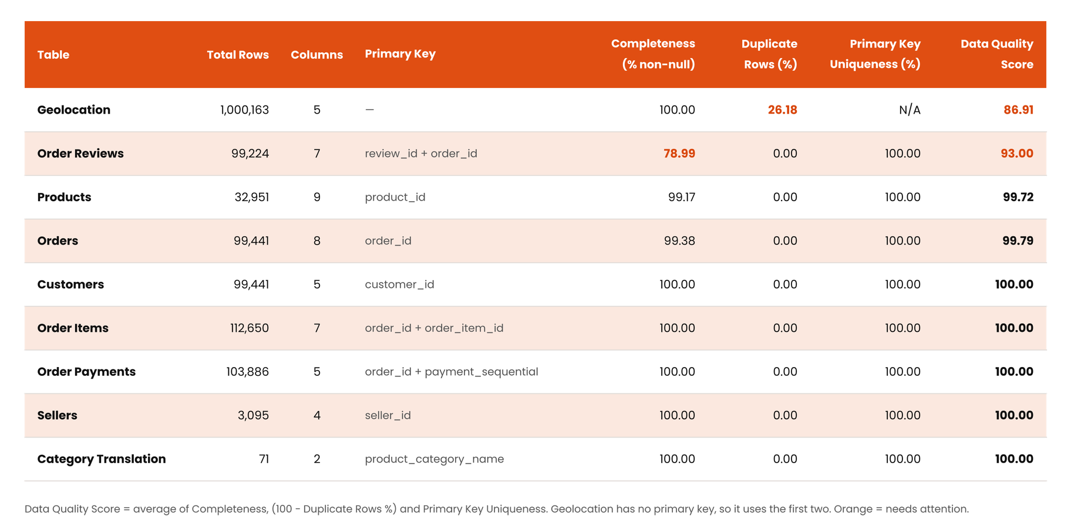
√
Table quality scores
7 of 9
Tables scored higher than
99%
2 tables pull quality down: geolocation (heavy row duplication) and order_reviews (optional comment fields mostly empty).

Slide 10
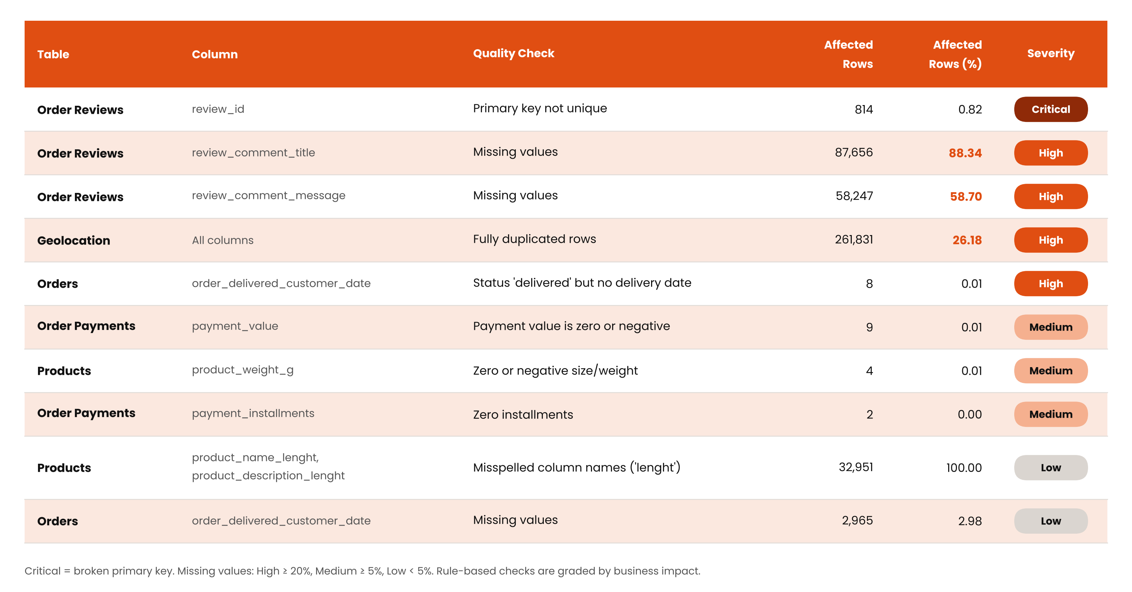
√
Key issues found

Slide 11
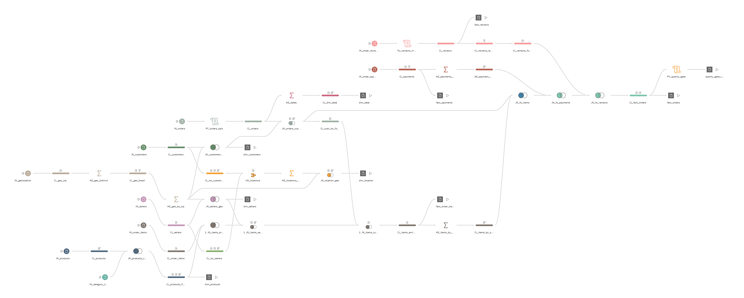
Tableau Prep flow overview
9 raw CSV files → 4 facts + 5 dimensions · 3 Python Script steps
1 · Input
2 · Clean
3 · Join / union
4 · Aggregate & calculate
5 · Output
Notes:
This is the full Tableau Prep flow. On the left are the nine raw CSV files from Kaggle. They go through cleaning containers, then joins and one union, then aggregations and calculated fields. Three Python Script steps run inside the flow. On the right are the nine published tables: four fact tables and five dimensions, written as Hyper files. The rest of this section walks through the flow stage by stage: what we cleaned, how we joined, which fields we calculated, and how many rows went in and came out.

Slide 12
Cleaning: from problem to fix
Table | Problem found in profiling | Fix in Tableau Prep | Result
Geolocation | 1,000,163 rows, 26.18 % duplicates, 42 points outside Brazil | Distinct → Brazil box filter → average lat/lng per zip | 1 point per zip prefix
Zip codes | Leading zeros lost when read as numbers | RIGHT(“00000” + STR(zip), 5) in customers, sellers, geo | 5-character text key
City names | Mixed formats, e.g. “sao paulo / sao paulo” (18 seller cities) | LOWER(TRIM()) · SPLIT on “/” and “,” | One spelling per city
Payments | 3 rows of type not_defined, 2 rows with 0 installments | Filter out not_defined · installments_clean: 0 → 1 | 103,886 → 103,883 rows
Products | 610 missing categories, 2 untranslated, 4 weights of 0 g, typo “lenght” | Manual EN mapping · weight ≤ 0 → NULL · columns renamed | English category for every product
Reviews | 814 duplicate review_id, 547 orders with 2+ reviews | Python Script step ranks per order, keep rank = 1 | 1 latest review per order
Every fix traces back to an issue measured in the profiling step.
Notes:
Every cleaning step answers a problem we measured in profiling. Geolocation had one million rows with over a quarter duplicated and 42 points outside Brazil, so we filter to a Brazil bounding box and average one point per zip code. Zip codes lost their leading zeros, so we pad them to five characters as text. City names came in mixed formats, so we trim, lower-case and split them. Payments had three undefined rows and two zero-installment rows. Products had missing and untranslated categories, zero weights and a misspelled column name. Reviews had duplicates, so a Python Script step ranks them and we keep the latest per order.

Slide 13
Joins & unions: no fan-out
fact_orders · one row per order
Dimensions
dim_customers · 99,441
customers LEFT JOIN geolocation on zip
order_items
112,650 rows
AG_items_by_order
COUNT · SUM · MAX
98,666 orders
1 per order
order_payments
103,883 rows
AG_payments_by_order
SUM · COUNT · MAX
99,437 orders
1 per order
dim_sellers · 3,095
sellers LEFT JOIN geolocation on zip
order_reviews
99,224 rows
Rank per order
keep the latest
98,673 orders
1 per order
dim_products · 32,951
products LEFT JOIN category translation
LEFT JOIN on order_id onto orders (99,441)
→ fact_orders: 99,441 rows, no duplicates
dim_location · 17,325
UNION of customer + seller places, then LEFT JOIN geolocation
11 joins, all LEFT JOIN from the fact grain · 1 union · no row duplicated, no row lost
Notes:
Joins are where data products usually break, because joining a one-to-many table multiplies rows. To avoid that, we aggregate each child table to one row per order first: order items, payments and the latest review. Then we left-join the three summaries onto the orders table, so fact_orders keeps exactly 99,441 rows, one per order. The dimensions are simpler: customers and sellers get coordinates from the geolocation table, products get English category names, and dim_location is a union of customer and seller places. In total the flow has eleven joins, all left joins from the fact grain, and one union.

Slide 14
Calculated fields we added
1
Delivery timing
2
Geography
delivery_days purchase → delivered
delay_days delivered − estimated date
is_late delay_days > 0
dq_flag suspicious dates: 203 flagged, kept
distance_km Haversine, seller → customer zip
is_cross_state seller_state ≠ customer_state
max_distance_km longest seller distance per order
n_sellers distinct sellers per order
3
Money
4
Products, reviews, dates
order_value items_value + freight_total
payment_gap total_paid − order_value
payment_mismatch |gap| > 1 BRL: 249 orders
freight_share freight ÷ item price
volume_cm3 length × height × width
is_low_score review_score ≤ 2
review_rank 1 = latest review of the order
is_weekend plus month, weekday in dim_date
Built to answer: what is associated with late deliveries and lower review scores?
Notes:
After cleaning and joining, we added calculated fields so the data can answer our problem statement. For delivery we compute delivery days, delay days and an is-late flag, plus a data-quality flag that marks suspicious date patterns on 203 orders instead of deleting them. For geography we compute the Haversine distance between seller and customer and whether the order crosses a state border. For money we compute order value, the gap between what was paid and what the order was worth, and flag 249 mismatches of more than one real. Finally product volume, a low-score flag for reviews, and calendar fields in the date dimension.

Slide 15
Output: rows before → after
Published table | Raw input rows | Published rows | What changed
fact_orders | 99,441 | 99,441 | items, payments, reviews aggregated, then joined
fact_order_items | 112,650 | 112,650 | + product, seller, distance_km, is_cross_state
fact_payments | 103,886 | 103,883 | 3 not_defined payments removed
fact_reviews | 99,224 | 99,224 | all kept; review_rank flags the latest per order
dim_customers | 99,441 | 99,441 | + zip text key, clean city, lat/lng
dim_sellers | 3,095 | 3,095 | + clean city, zip text key, lat/lng
dim_products | 32,951 | 32,951 | + category_en, volume_cm3; 0 g weight → NULL
dim_location | 1,000,163 | 17,325 | customer + seller places, 1 point per zip
dim_date | 99,441 | 634 | 1 row per purchase day, with calendar fields
0
rows lost without a reason (reconciled to raw)
203
suspicious orders flagged with dq_flag, kept
41 / 44
quality-gate checks pass, none fail
Notes:
Here is the proof that the flow does not silently lose data. Orders, order items, reviews, customers, sellers and products keep every row. Payments drop from 103,886 to 103,883, exactly the three not-defined rows we removed on purpose. The geolocation table shrinks from over a million rows to 17,325 customer and seller places, and the date dimension has one row per purchase day, 634 in total. The quality gate checks every one of these counts against the raw data. 41 of 44 checks pass, 3 are documented warnings, and none fail. The 203 suspicious orders are flagged, not deleted.

Slide 16





Reproducible Pipeline
Every Tableau Prep cleaning step is also a reusable Python function
olist_functions.py
clean_orders() · used by Python and by Prep
one function per Prep step · clean_orders(), clean_reviews(), build_fact_orders() …
def clean_orders(orders):
o = orders.copy()
o["delivery_days"] = days(purchase, delivered)
o["delay_days"] = days(estimated, delivered)
o["is_late"] = o["delay_days"] > 0
o["dq_flag"] = np.select(rules, labels,
default="ok")
return o
Stand-alone Python
Inside Tableau Prep
run_pipeline.py
9 tables in ~10 s
3 Script steps via TabPy
PY_orders_kpis · PY_reviews_ranked · PY_quality_gate
Design rules
Pure functions
table in → new table out; input never changed
No hidden state
no hard-coded paths, no randomness, no today()
Same quality gate → same 9 published tables
4 facts + 5 dimensions · manifest.json with SHA-256 of inputs, code and outputs
Rules in one place
Brazil box, low score ≤ 2, mismatch > 1 BRL as constants
One copy of the logic
Prep scripts import the functions instead of copying them
Notes:
We rewrote every Tableau Prep cleaning step as a small Python function in olist_functions.py. The same functions run in two ways: stand-alone with one command, or inside Tableau Prep through three Script steps that call TabPy. The Prep scripts import the functions instead of copying them, so there is only one version of each rule. The functions are pure, have no hard-coded paths or randomness, and every business rule is a named constant, so the same input always gives the same output.

Slide 17



Same Result, Every Time
Three automated tests in test_reproducibility.py, run on our Kaggle data
PASS
PASS
PASS
Identical re-run
Stable on new data
Bad data is blocked
Run twice on the same data → all 9 output files have the same SHA-256 fingerprint
Snapshot to Dec 2017 (45,430 orders) vs full data (99,441) → every 2017 order unchanged
Duplicate order + orphan item injected → quality gate FAILS, nothing is published
Python and Tableau Prep give the same numbers
manifest.json
Measure | Python | Tableau Prep
Locations (dim_location) | 17,325 | 17,325
Orders flagged by dq_flag | 203 | 203
Payment mismatch > 1 BRL | 249 | 249
Items without distance | 555 | 555
Quality gate | 41 PASS · 3 WARN · 0 FAIL | 0 FAIL
Every run stores the fingerprint of each input file, of the code and of each output table, plus the gate result.
Any number in our analysis can be traced back to the exact data and code that produced it.
Notes:
We proved reproducibility with three tests. Running the pipeline twice gives byte-identical files. Running it on an older snapshot and then on the full data leaves every 2017 order unchanged, so new data does not rewrite history. When we injected broken data, the gate stopped the publish. And Python and Tableau Prep give exactly the same numbers: 17,325 locations, 203 flagged orders and 249 payment mismatches.

Slide 18


What the Quality Gate Caught
Checks on keys, links, value ranges and row counts before anything is published
Bug in the Tableau Prep flow
Dates lost between Prep and Python
15,234 → 17,325
96,478 → 203
rows in dim_location
orders flagged
Cause Sellers were labelled "customer", so their locations merged with customer locations.
Cause Prep sends dates as 2017-10-10T21:25:13Z[UTC]; the first run read none of them.
Fix Check "both roles present" → FAIL → fixed in CL_loc_sellers
Fix New date parser + two new FAIL checks: ≤ 1 % flagged, delivered orders need a date
Lesson learned a quality gate gets better with every real run, and it must block bad data, not only report it.
Notes:
The gate found two real problems. First, a bug in our Tableau Prep flow: seller locations were labelled as customers, so dim_location had 15,234 rows instead of 17,325. The check "both roles present" failed and we fixed the flow. Second, when we moved the Python functions into Prep, the dates arrived in a format we did not expect and 96,478 orders were wrongly flagged. The gate only warned, so we made it stricter with two new FAIL checks. Now the same run gives the correct 203 flagged orders.

Slide 19




Governance
Who owns the data, where it comes from, what it means and what can go wrong
Roles
Data dictionary
Data owner (raw) | Olist / Kaggle
Data owner (published) + metadata steward | Fred
Data quality steward | Gaurav
Transformation steward (Tableau Prep) | Hrithik
Pipeline & governance steward | Akshay
Data users (read-only) | Sahil
9
132
tables
columns
Per column: type, description, transformation rule, null %, sensitivity (public · pseudonymous ID · quasi-identifier · free text)
Generated from the data by build_data_dictionary.py, so it never goes out of date.
Lineage
AI risks → mitigation
Kaggle
9 CSV files
Raw zone
never edited
Python
preprocessing
Personal data keep location at zip-prefix level
Regional bias (São Paulo) report results per state
Free-text reviews human check, remove names
Licence CC BY-NC-SA non-commercial, attribution
AI-assisted code review + gate + Python-vs-Prep
Tableau Prep
+ Script steps
Quality gate
FAIL blocks
Published
star schema
Row 1 continues into row 2 · every run logged in manifest.json
Notes:
Every table has an owner and a steward: Fred owns the published dataset, Gaurav the quality rules, Hrithik the Tableau Prep flow, and I maintain the Python functions, the quality gate, lineage and the data dictionary. Sahil uses the data read-only. The lineage goes from the Kaggle files through a raw zone that is never edited, preprocessing, Tableau Prep and the quality gate to the published star schema. The data dictionary covers all 132 columns and is generated from the data. The main AI risks are re-identification through location, regional bias, the Portuguese free text, the non-commercial licence and AI-assisted code, each with a mitigation.

Slide 20
Conclusion
Can this data be trusted, reused and fed into an AI model — and how do you prove it?
TRUSTED
REUSED
AI-READY, WITH LIMITS
41 / 44
25 / 26
4
quality-gate checks pass · 0 FAIL
FAIR points (96.15 %)
documented risks
Row counts reconcile to the raw data. Bad data is blocked before publishing.
Identical SHA-256 fingerprints on re-run. 9 tables, 132 columns documented.
Location is a quasi-identifier, free text needs a human check, Southeast bias, non-commercial licence.
What the clean data tells us about late deliveries
62 % vs 9 %
4.5 % → 12 %
8.0 % vs 4.5 %
of late vs on-time orders get a low review score (≤ 2)
late-delivery rate, sellers ≤ 100 km vs > 2,000 km away
late rate, cross-state vs same-state orders
Delivered orders only (96,478), measured on fact_orders.
Lessons learned dedupe geolocation first · keep zip codes as text · flag suspicious rows, don’t delete them · a quality gate must block, not just report
Notes:
So, can this data be trusted, reused and fed into an AI model, and how do we prove it? Trusted: 41 of 44 quality checks pass, none fail, and every row count reconciles to the raw data. Reused: it scores 25 out of 26 on the FAIR assessment, every re-run produces identical fingerprints, and all 132 columns are documented. AI-ready with limits: we documented four risks, location as a quasi-identifier, Southeast bias, free-text reviews and the non-commercial licence. And the clean data answers our problem statement: late orders get low review scores about 62 percent of the time versus 9 percent for on-time orders, and the late rate rises from 4.5 percent for nearby sellers to 12 percent beyond 2,000 kilometres. Our main lessons: dedupe geolocation first, keep zip codes as text, flag instead of delete, and make the quality gate block bad data.

Slide 21
Thank You

